Slide 1
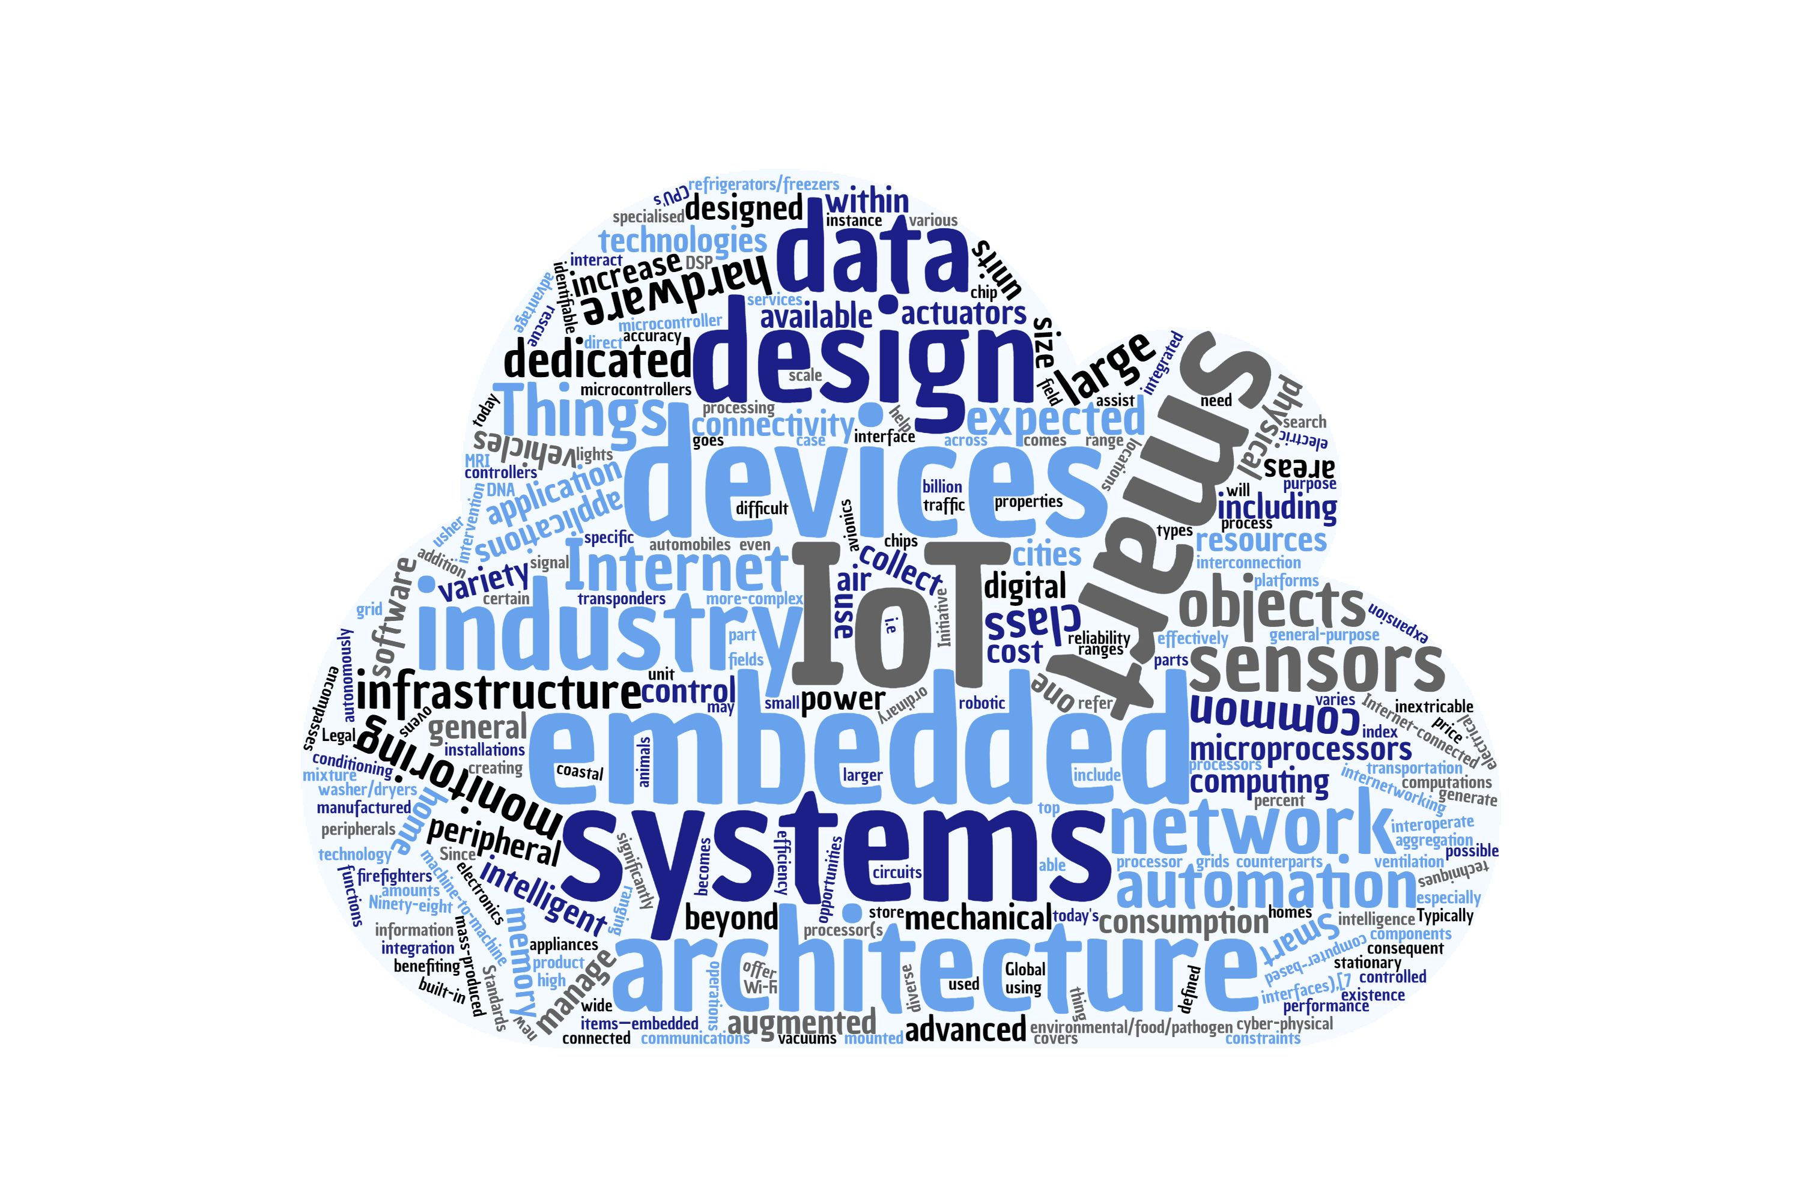
Development and Evaluation of a Web of Thing-compliant Robot-Arm Simulation Framework Master’s thesis Zucheng Han zucheng.han@tum.de Supervisor: Fady Salama Embedded Systems and Internet of Things Department of Computer Engineering

Slide 2
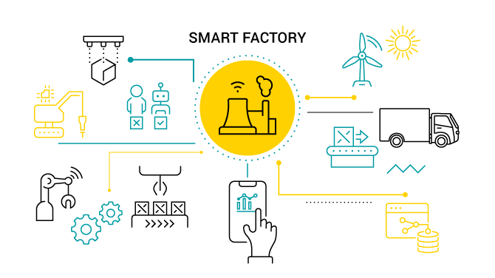

Introduction
For the purpose of managing IoT devices from different IoT protocols, researchers and engineers have willing to design a common standard or platform.
The W3C Web of Things (WoT) aims at describing and complementing the existed IoT standards and mechanisms. ^{[1]}
Figure: Smart factory
Figure: Web of Things
Source: Smart factory https://www.avsystem.com/blog/smart-factory/

Slide 3
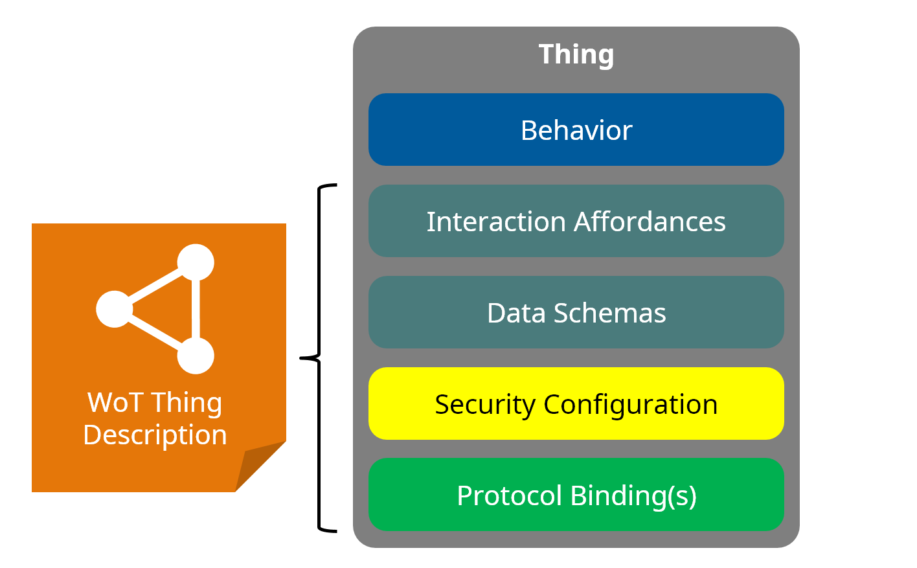
Thing Description
The Thing Description (TD) records the available affordances of IoT devices and it also shows how the IoT devices connected to the web.
TD document is composed of three interaction affordances: Properties, Actions and Events.
Figure: Architecture Aspect of a Thing^{[1]}
Reference: [1] Lagally, M., Matsukura, R., McCool, M., & Toumura, K. (2023, January 19). Web of Things (WoT) Architecture 1.1. https://www.w3.org/TR/wot-architecture11/

Slide 4
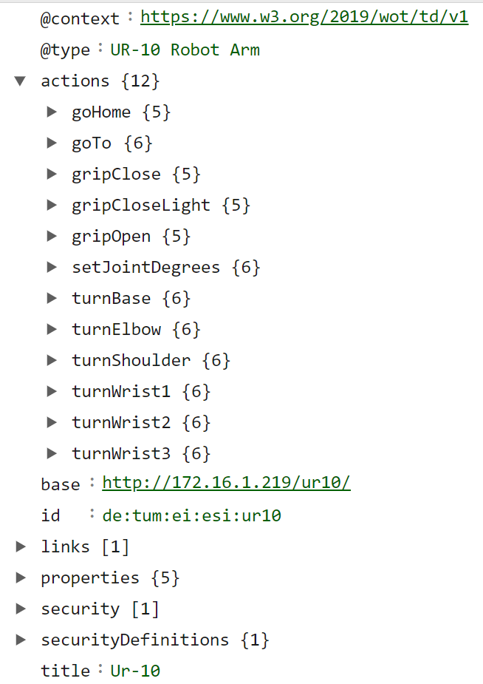
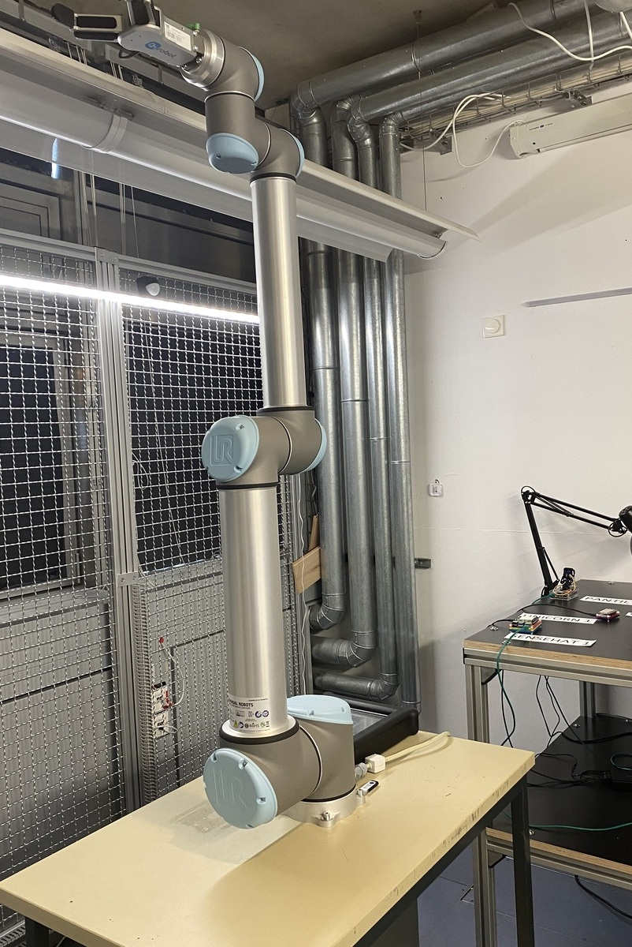
Motivation
User-defined TD is highly coupled to the devices
The TD document, which has ability to represent all features of device and owns scalability and portability to same type devices, will be popular for developers
Figure: Thing Description for UR10 robot
Figure: UR10 robot in the lab

Slide 5
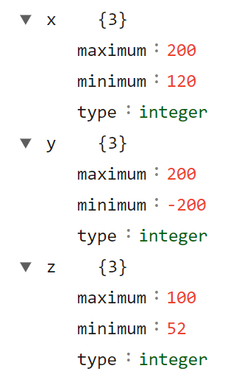
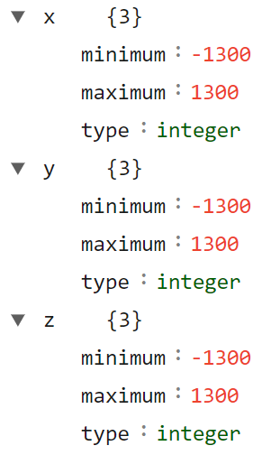
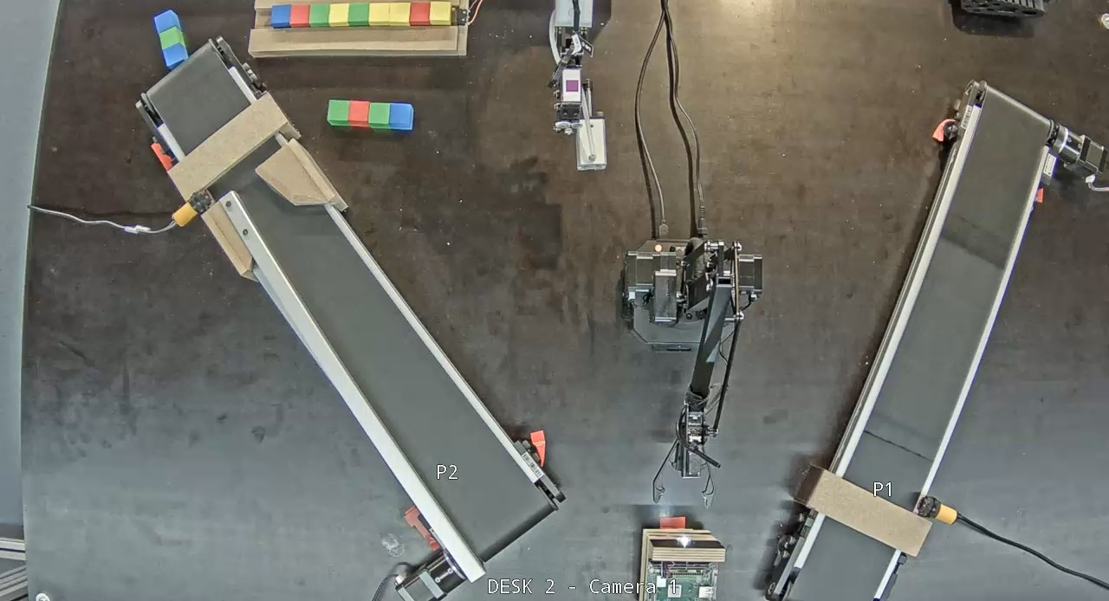
Motivation
JSON schema could only validate the linear restrictions of workspace in Thing Description
The estimation of robotic workspace in the real robot will be a complex and dangerous job
Figure: Workspace restrictions for Uarm and UR10 robot
Figure: IoT remote platform

Slide 6
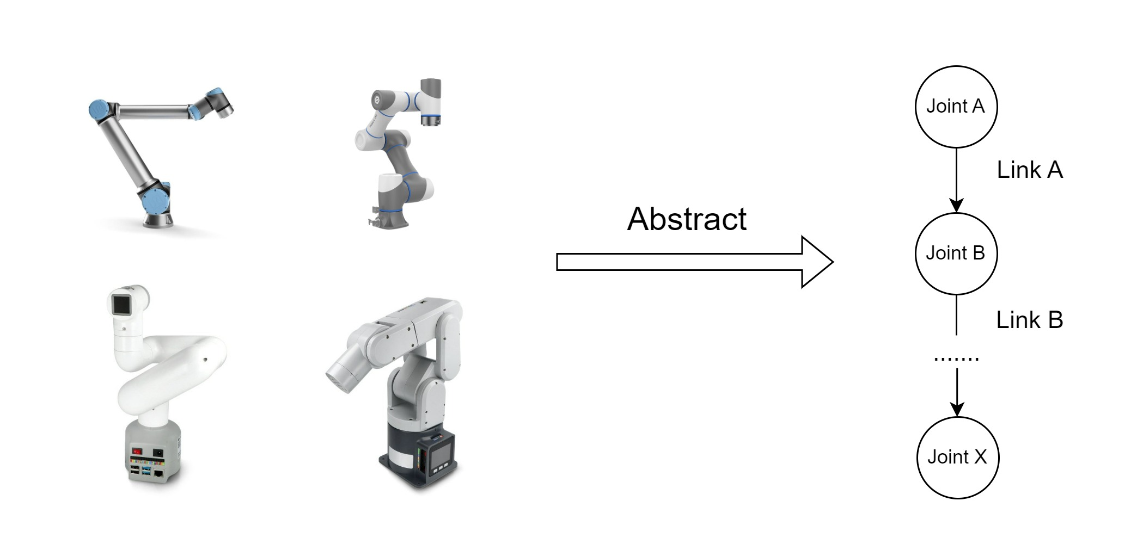
Problem Statement
The common structure of robotic TD document could accurately describe the kinematics characteristic of the most Robot-Arm in the market and the current workspace of robot.
Figure: Robot mechanical structure

Slide 7
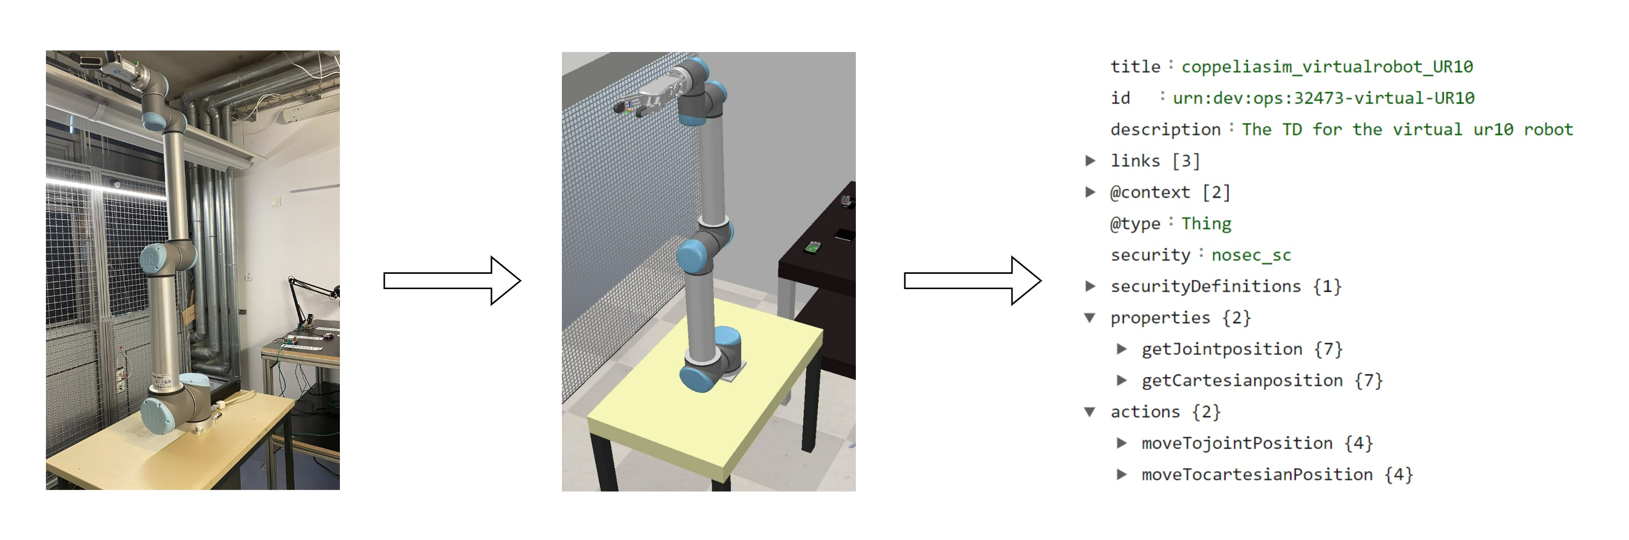
Problem Statement
The common structure of robotic TD document could accurately describe the kinematics characteristic of the most Robot-Arm in the market and the current workspace of robot.
The framework to automatically generate fully functional and same reactive digital twin of robots and automatically produce the corresponding robotic TD
Figure: Automatic generation of robotic digital twin and TD

Slide 8
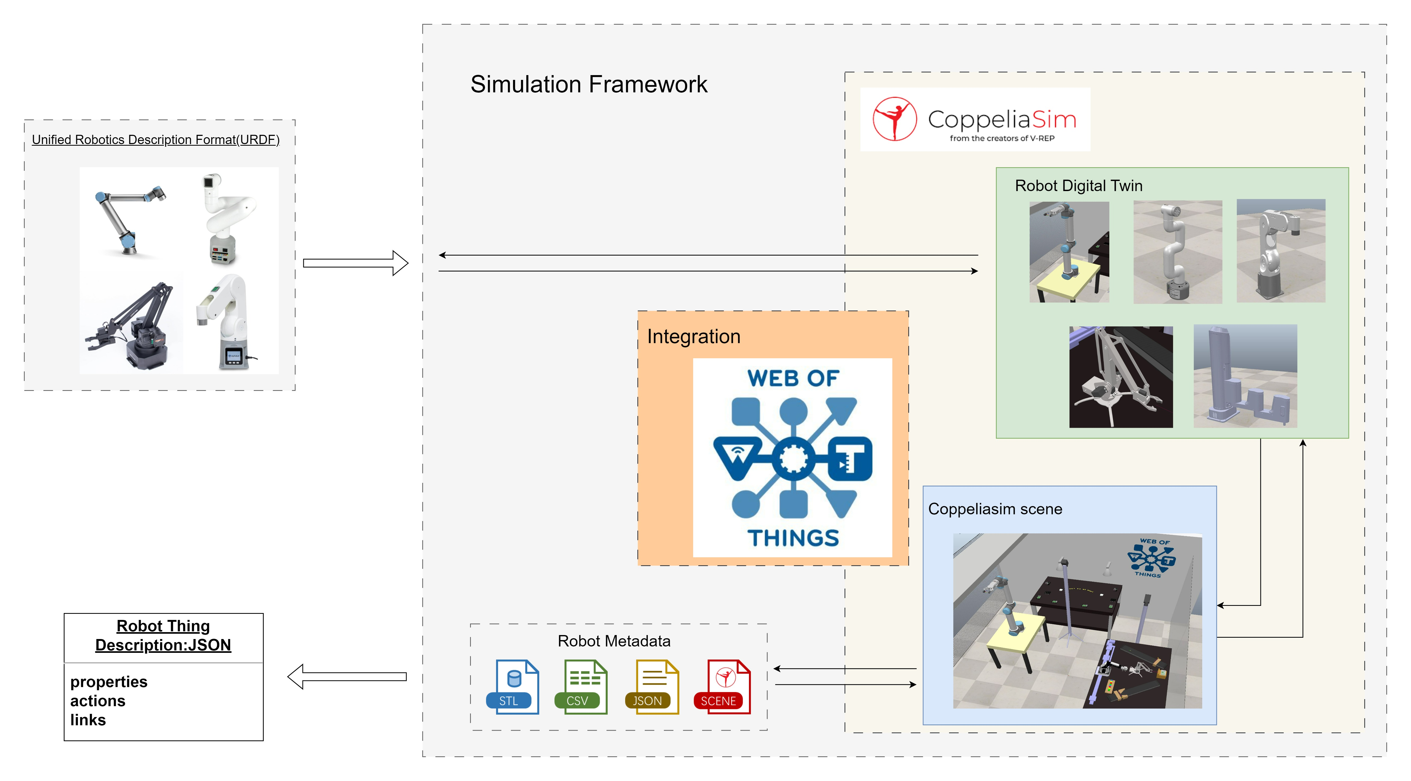
Intuition
Figure: Illustration of idea in master thesis

Slide 9
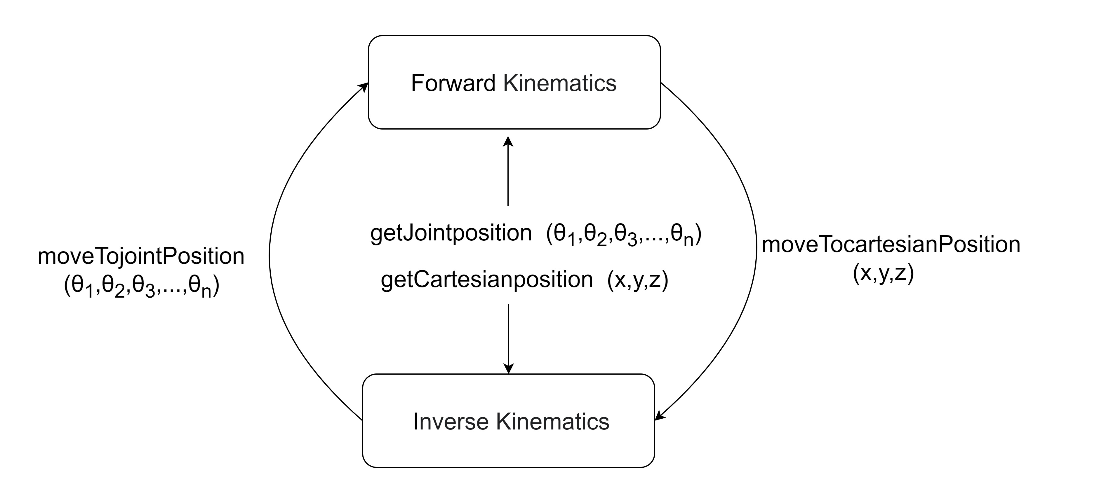
Robot Thing Description
The available interaction affordances in our robot Thing Description:
moveTojointPosition
moveTocartesianPosition
getJointposition
getCartesianposition
Actions
Properties
Figure: The relationship between interactions in TD and robotic kinematics

Slide 10
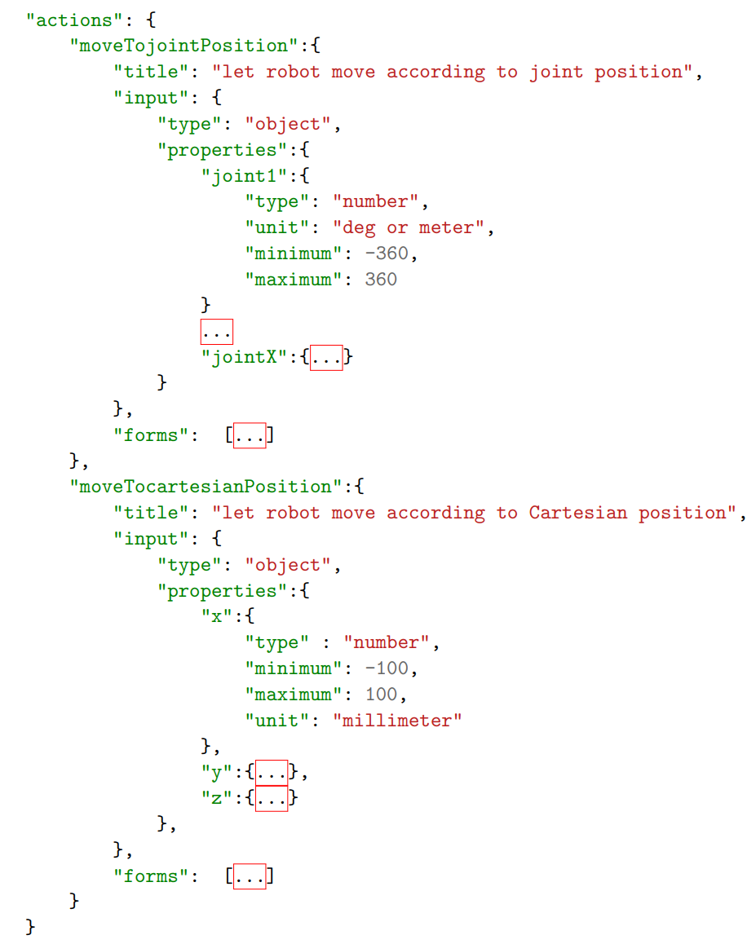
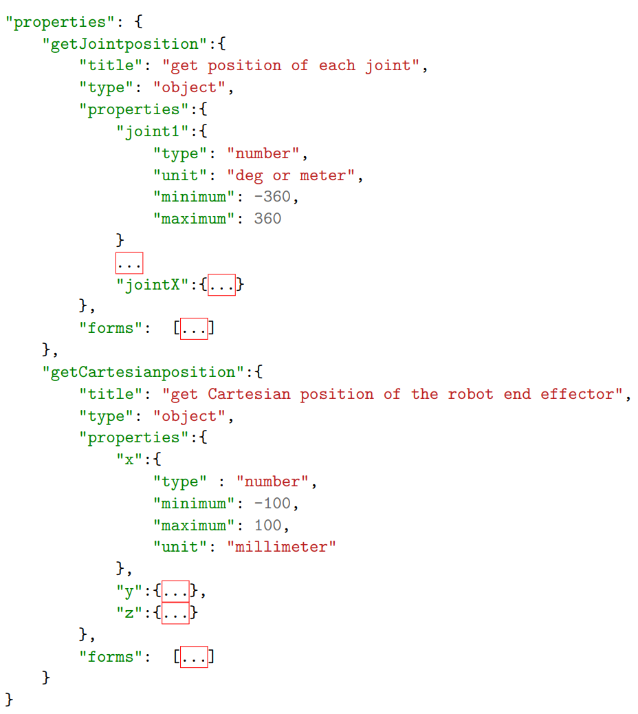
Figure: The interaction affordances in our robot TD

Slide 11
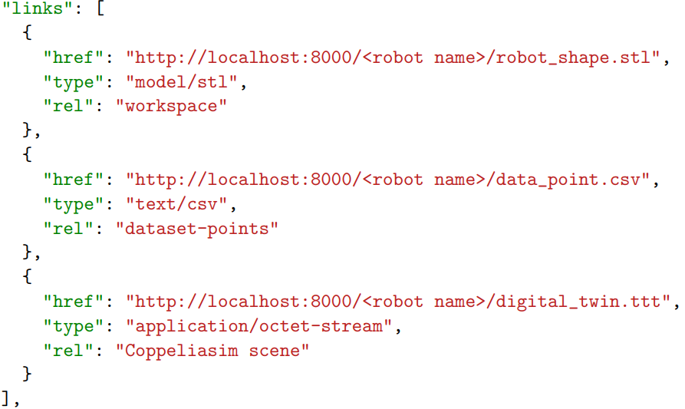
Metadata in Robot Thing Description
The link part in TD is used to store related metadata and recover robotic workspace shape
Figure: The link part in our robot TD

Slide 12
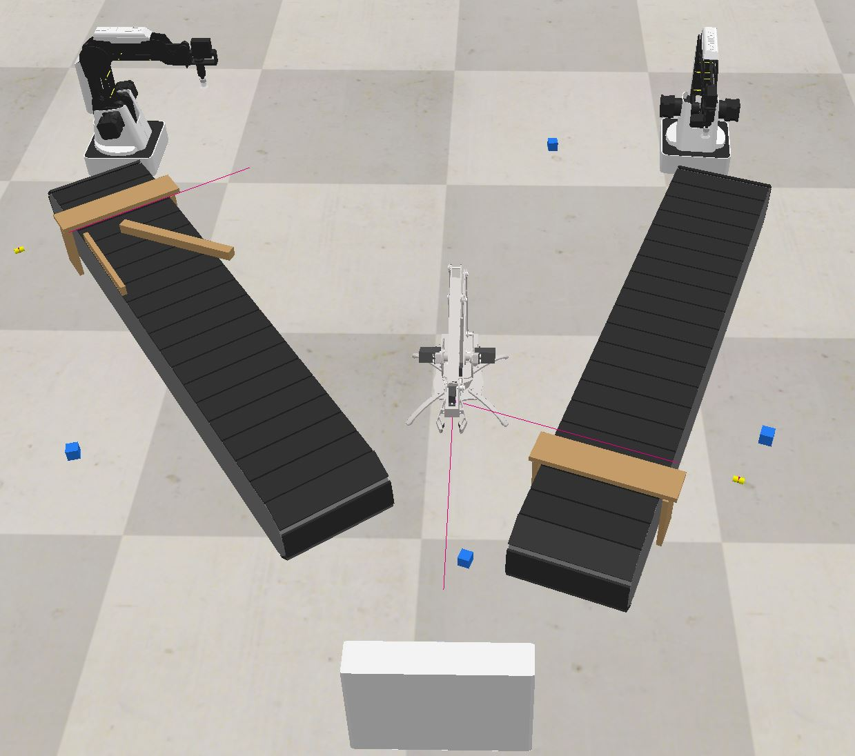
Simulation Framework: Integrate WoT with Coppeliasim
The WoT library is code by Typescript
The remote API in Coppeliasim could also be invoked by Typescript
Figure: Virtual scene – IoT lab

Slide 13
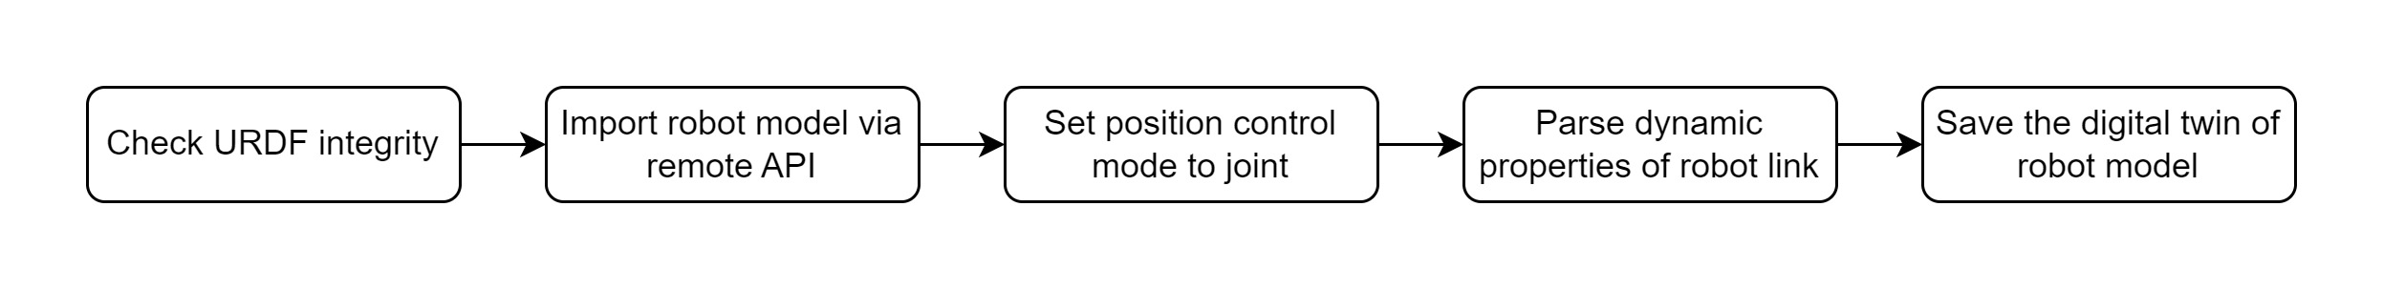
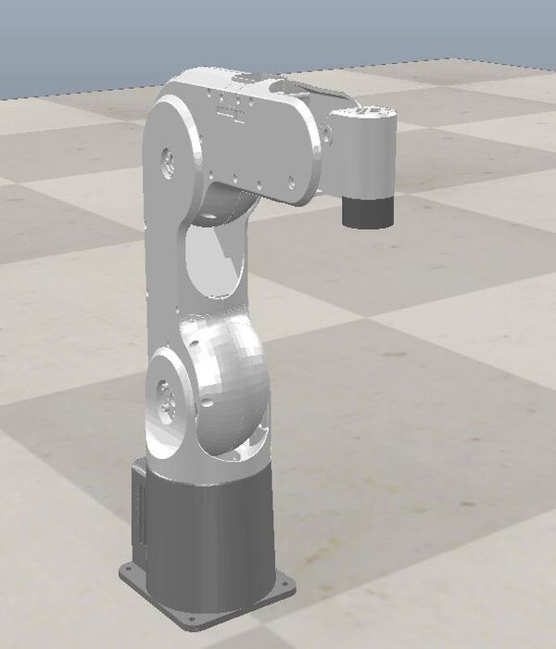
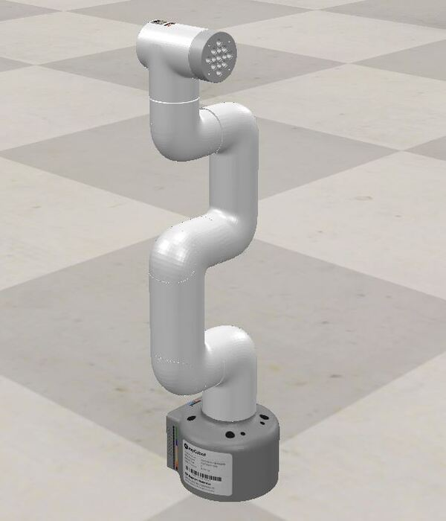
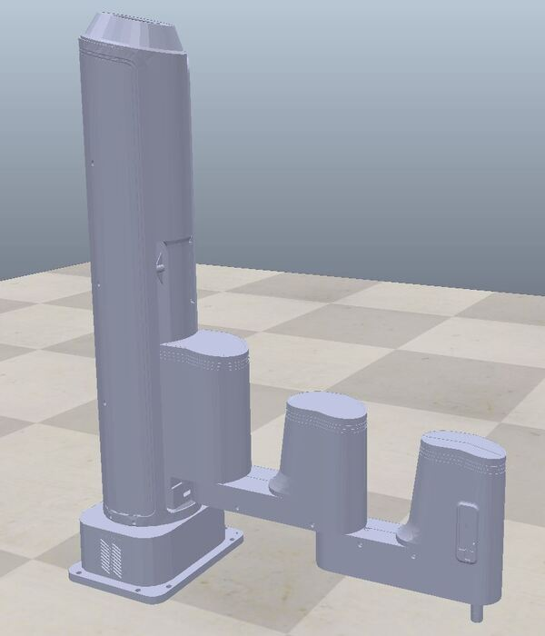
Simulation Framework: From URDF to digital twin robot
Unified Robot Description Format (URDF) could express robotic mechanical structure and dynamic properties of robot
URDF Digital twin of robot Thing Description of robot
Figure: Some robot digital twin imported from URDF

Slide 14
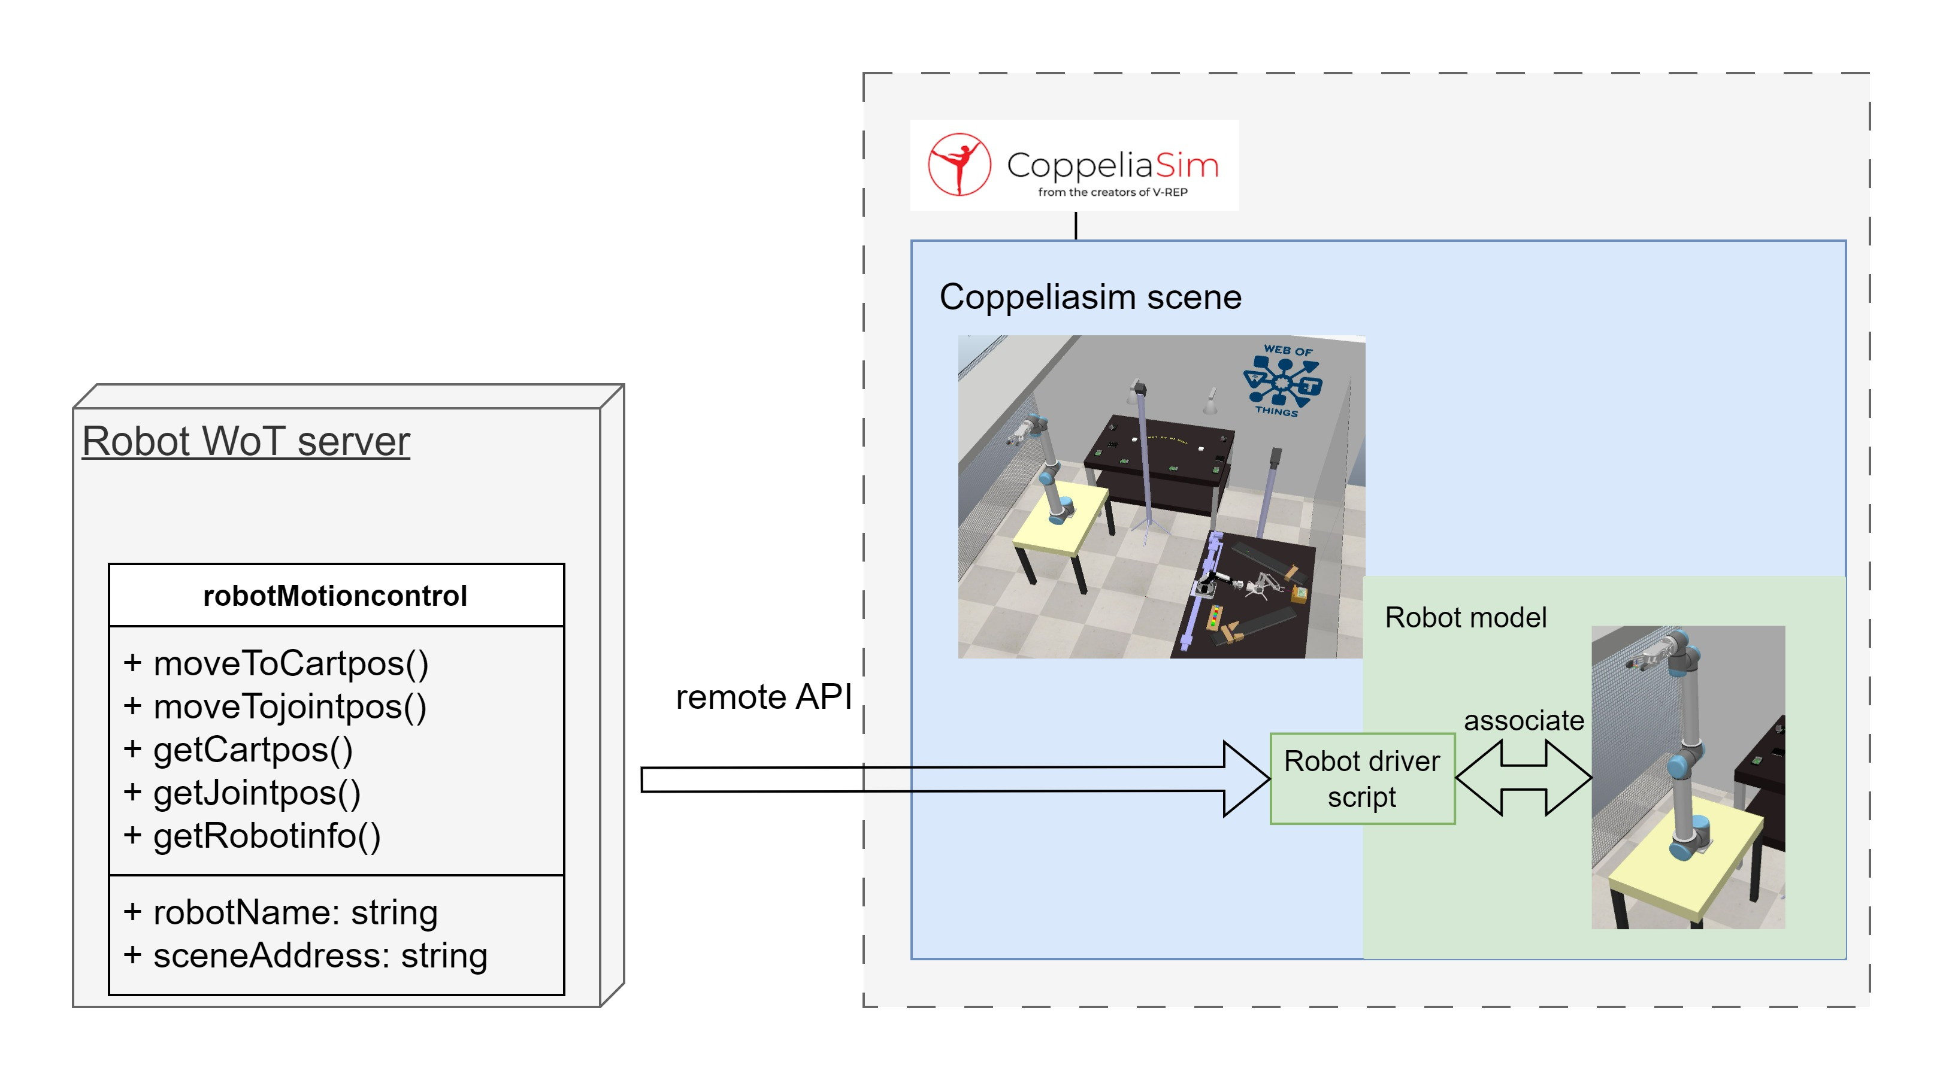
Simulation Framework: Automatic IK conversion
The robotic TD only provides how to invoke affordances of devices and it doesn’t involves the specific IK conversion
Figure: Interact with robot digital twin via driver script

Slide 15
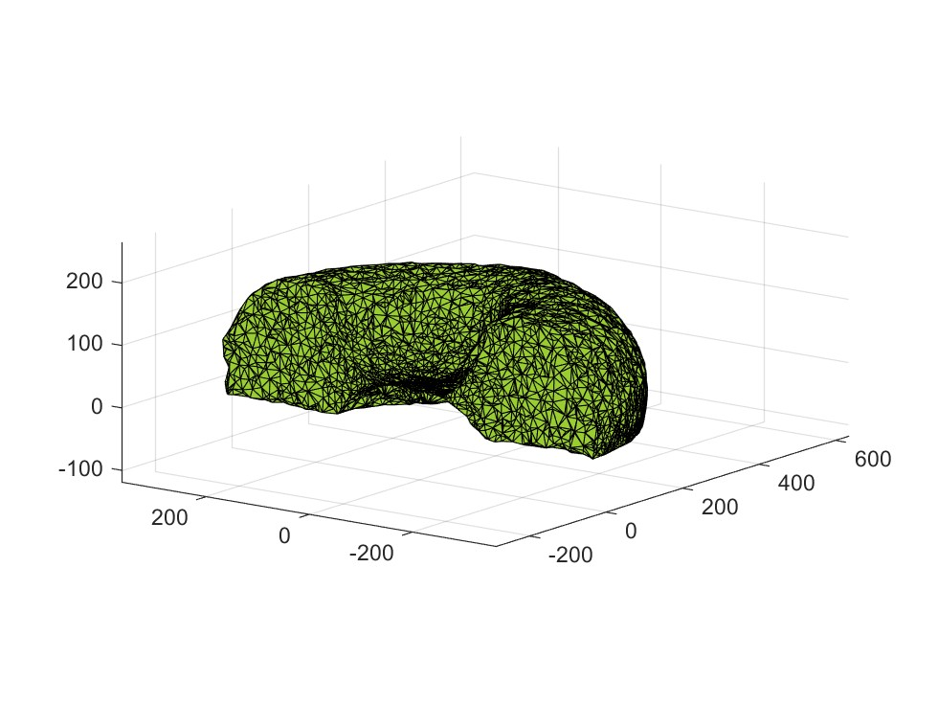
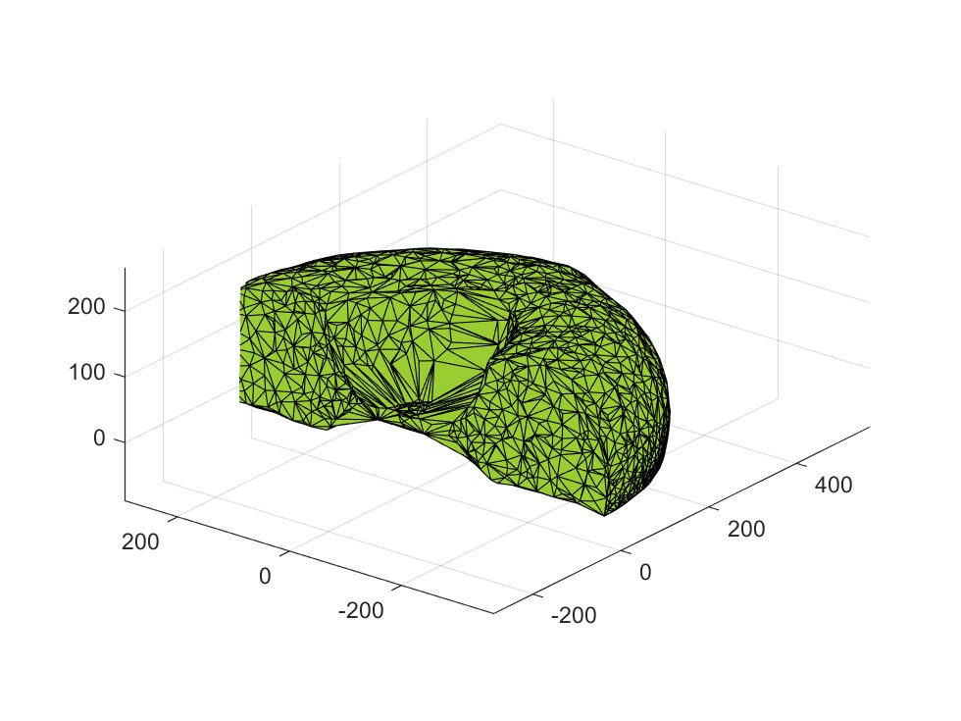
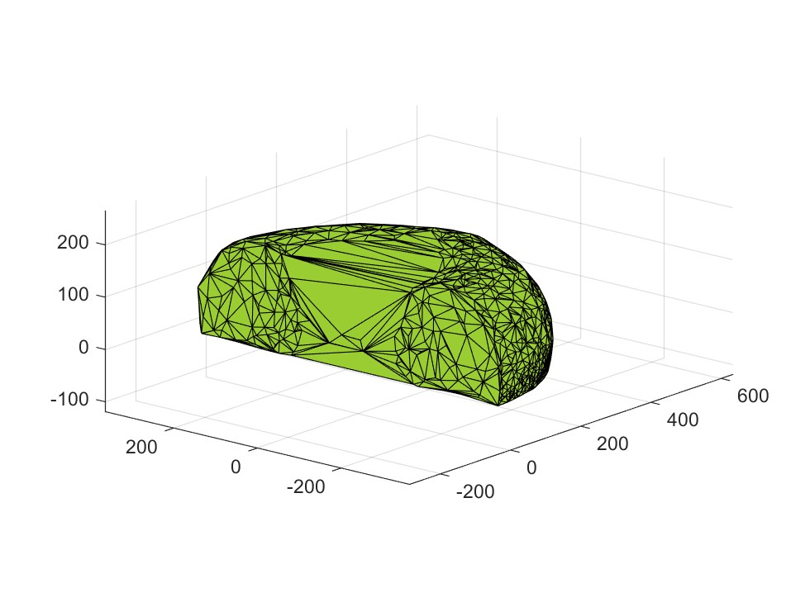
Simulation Framework: Automatic workspace generation
The robotic workspace generation algorithm only is used for the digital twin of robot
Using point cloud with collision state to generate workspace
Surface Reconstruction: Alpha-shape method^{[2]}
Robotic workspace simplification: Convex polyhedron shape at high alpha value
α = 20
α = 100
α = 400
Figure: Surface reconstruction based on different alpha value
Reference: [2] Edelsbrunner, H., Kirkpatrick, D., & Seidel, R. (1983). On the shape of a set of points in the plane. IEEE Transactions on information theory, 29(4), 551-559.

Slide 16
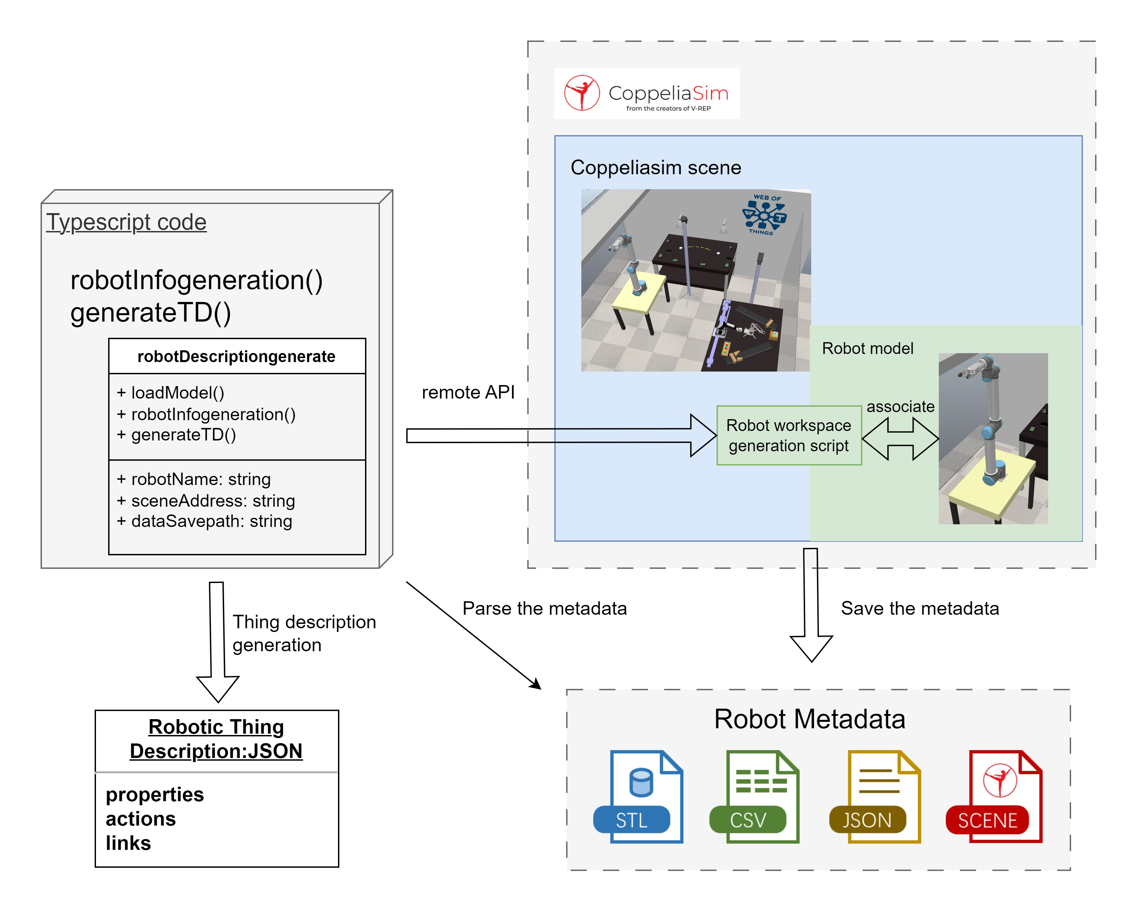
Simulation Framework: Automatic TD generation
Figure: Automatic TD generation

Slide 17
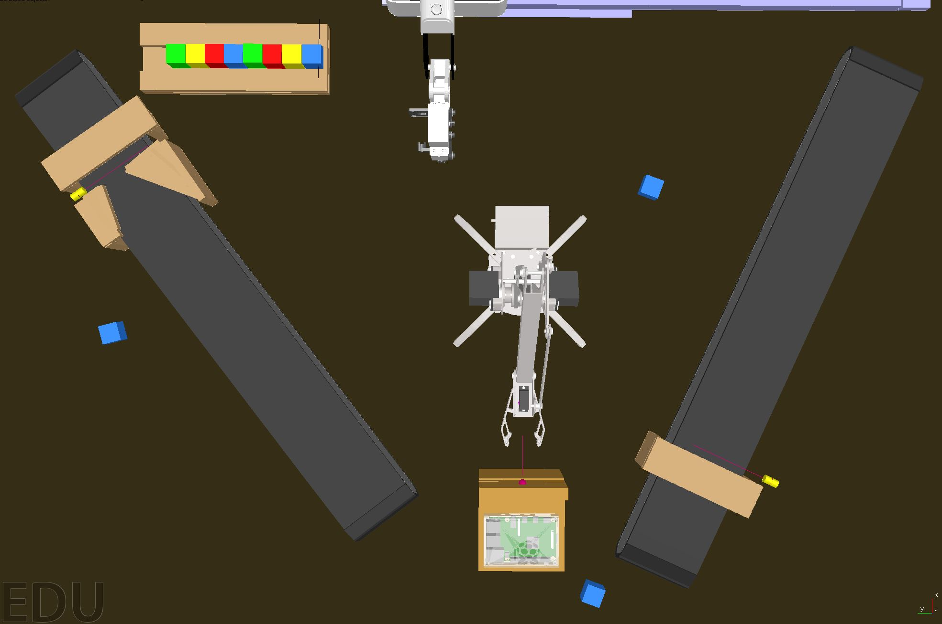
Simulation Framework: Construct Digital twin scene
Same full functionality & Same response ability
Figure: The digital twin of IoT platform

Slide 18
Simulation Framework: Construct Digital twin scene
Same full functionality & Same response ability
Figure: The real IoT platform

Slide 19
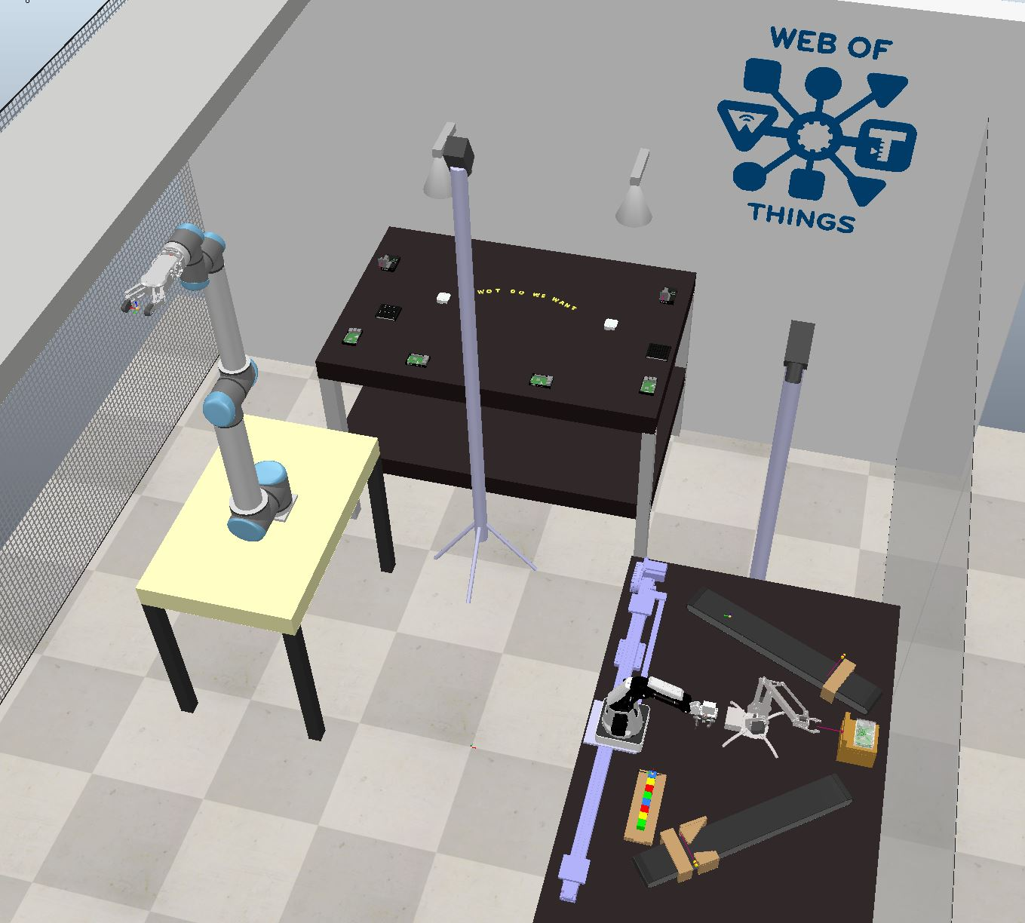
Simulation Framework: Construct Digital twin scene
Same full functionality & Same response ability
Figure: The digital twin of IoT lab

Slide 20
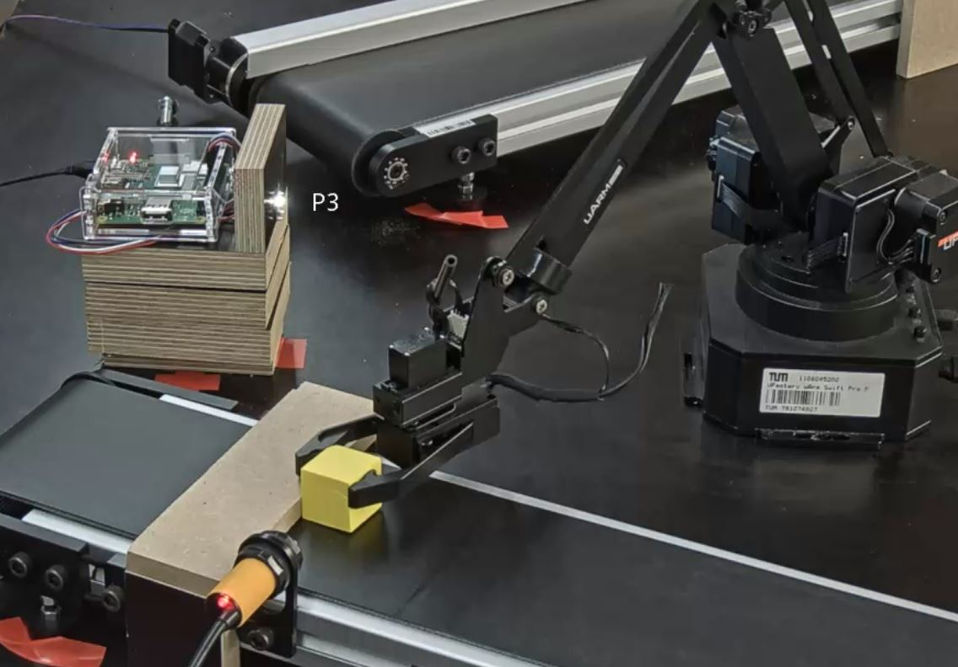
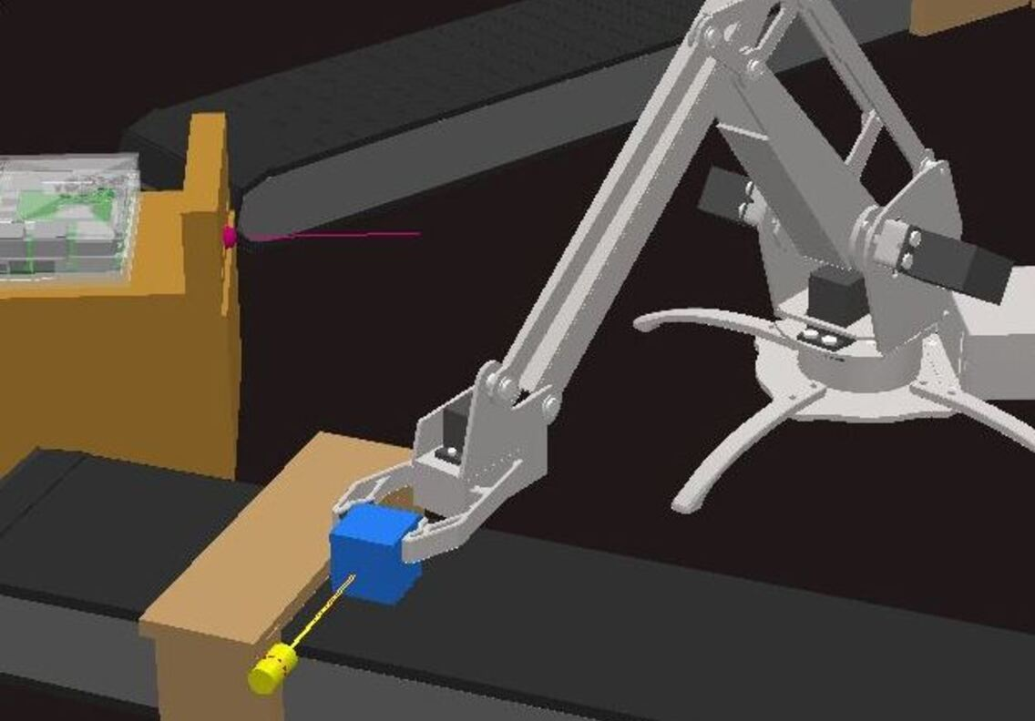
Evaluation results: Digital twin scene of IoT platform
Figure: Clamp cube by Uarm

Slide 21
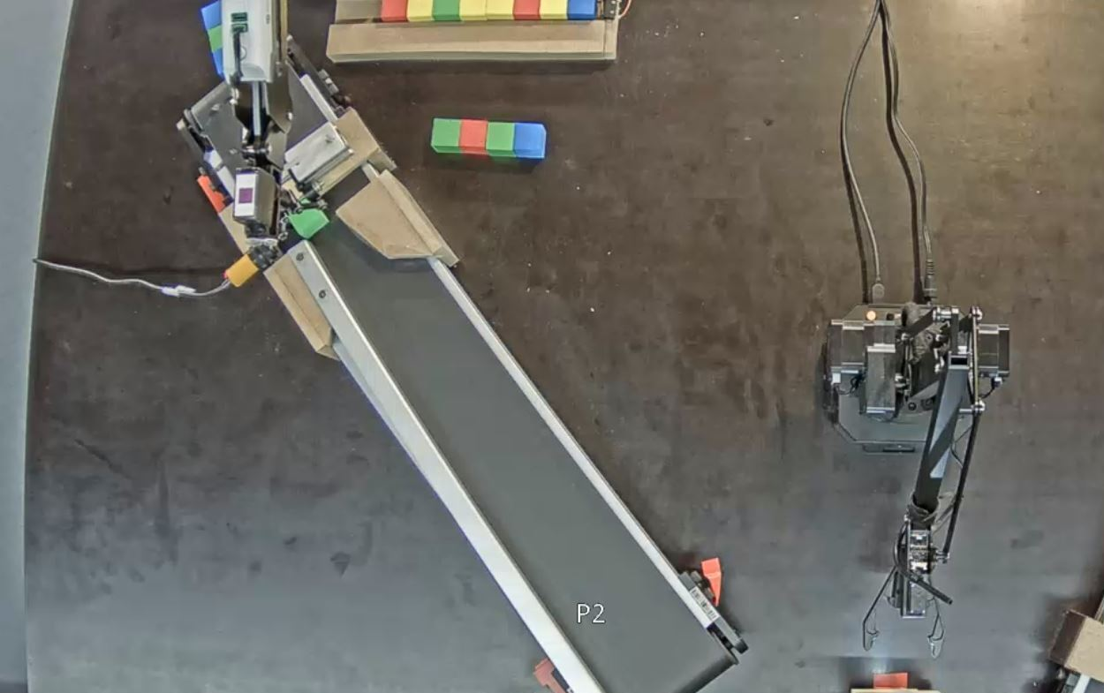
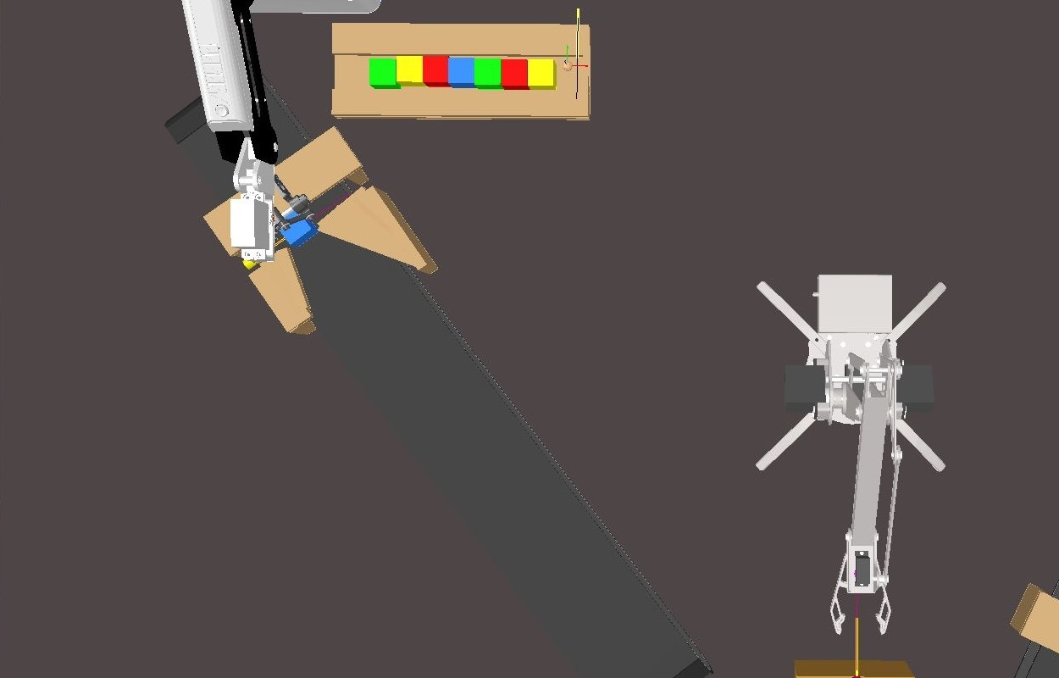
Evaluation results: Digital twin scene of IoT platform
Figure: Cube return by virtual Dobot

Slide 22
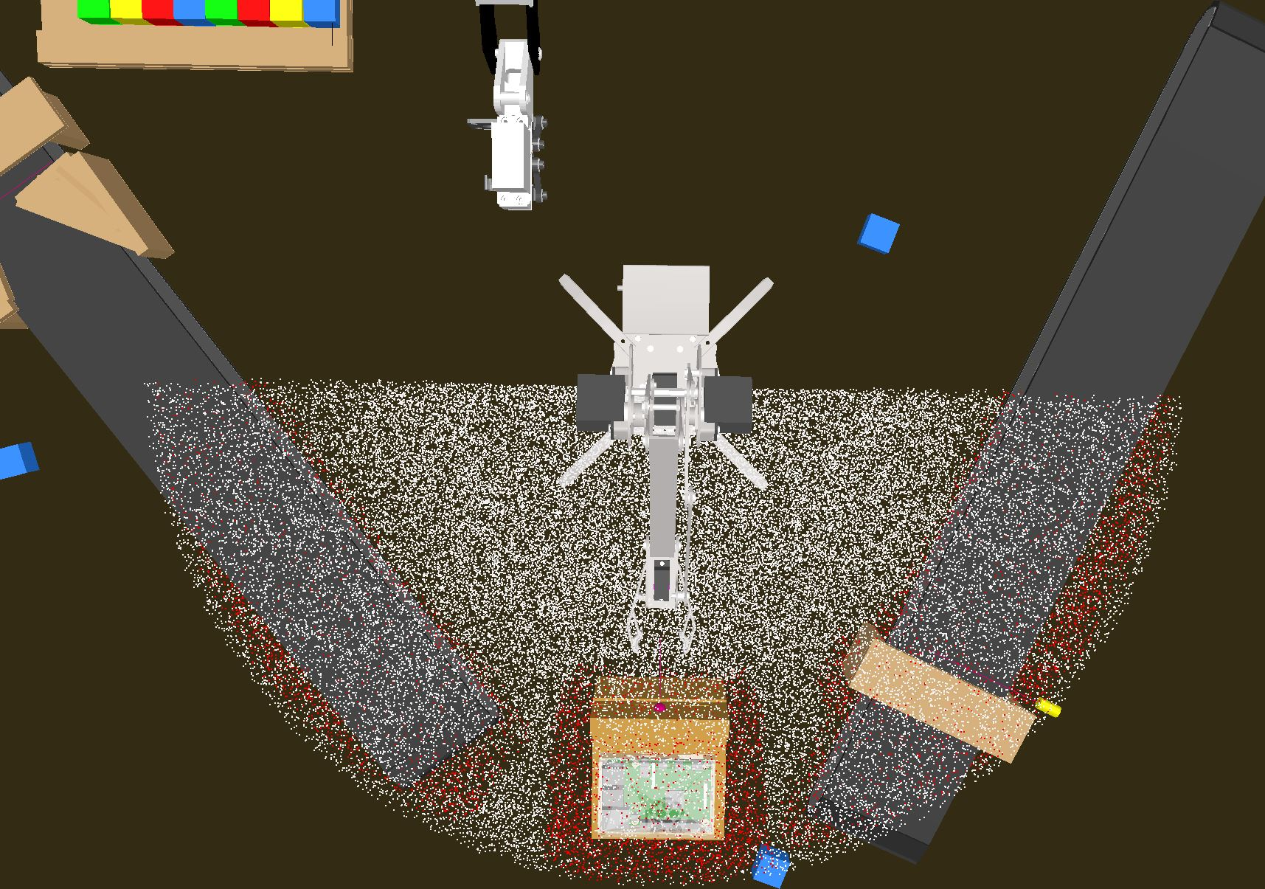
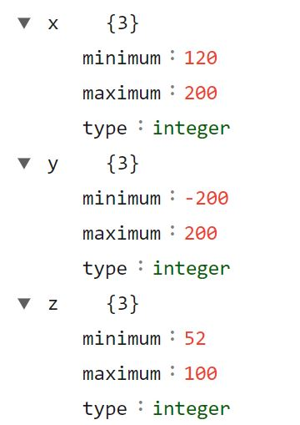
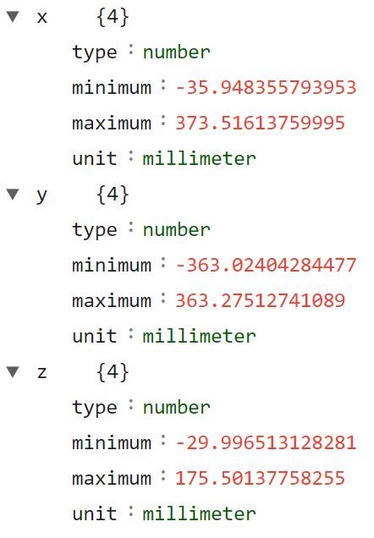
Evaluation results: Thing Description in Uarm
Figure: The workspace of Uarm and collision state(top view)
Figure: Cartesian restrictions in Uarm Thing Description

Slide 23
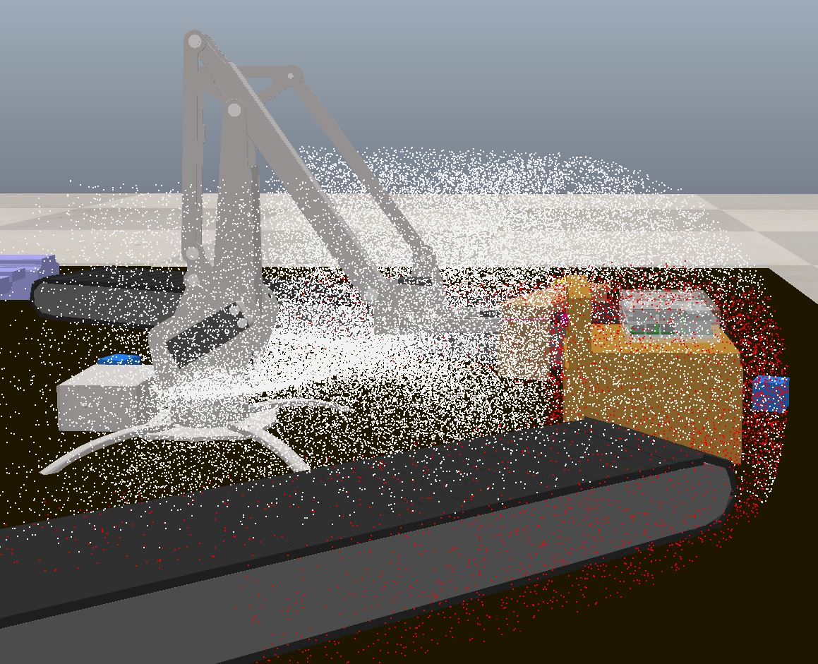
Evaluation results: Thing Description in Uarm
Figure: The workspace of Uarm and collision state(side view)
Figure: Cartesian restrictions in Uarm Thing Description

Slide 24
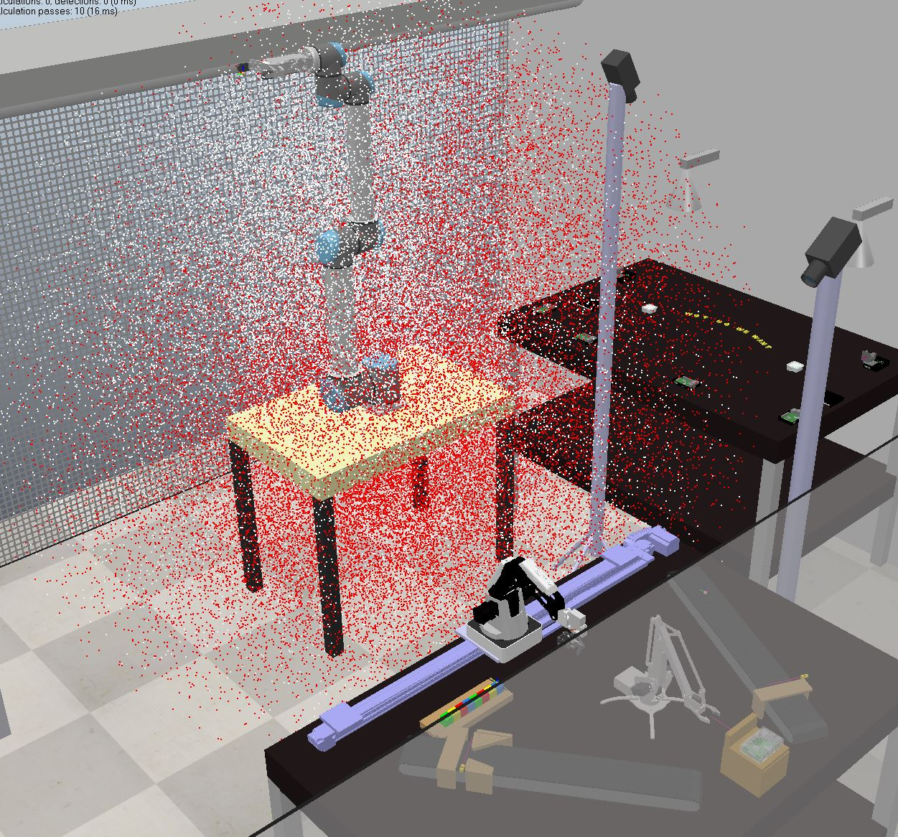
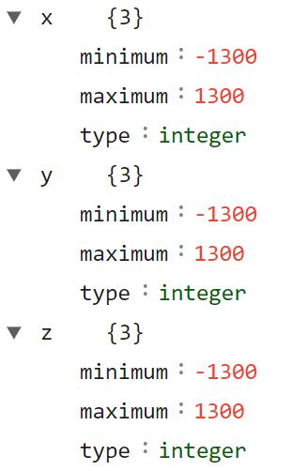
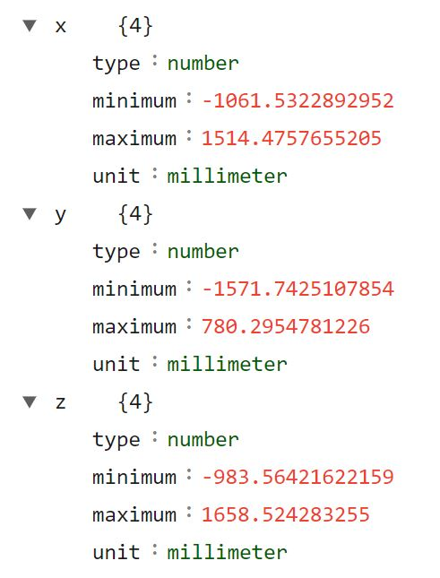
Evaluation results: Thing Description in UR10
Figure: The workspace of UR10 robot and collision state
Figure: Cartesian restrictions in UR10 Thing Description

Slide 25
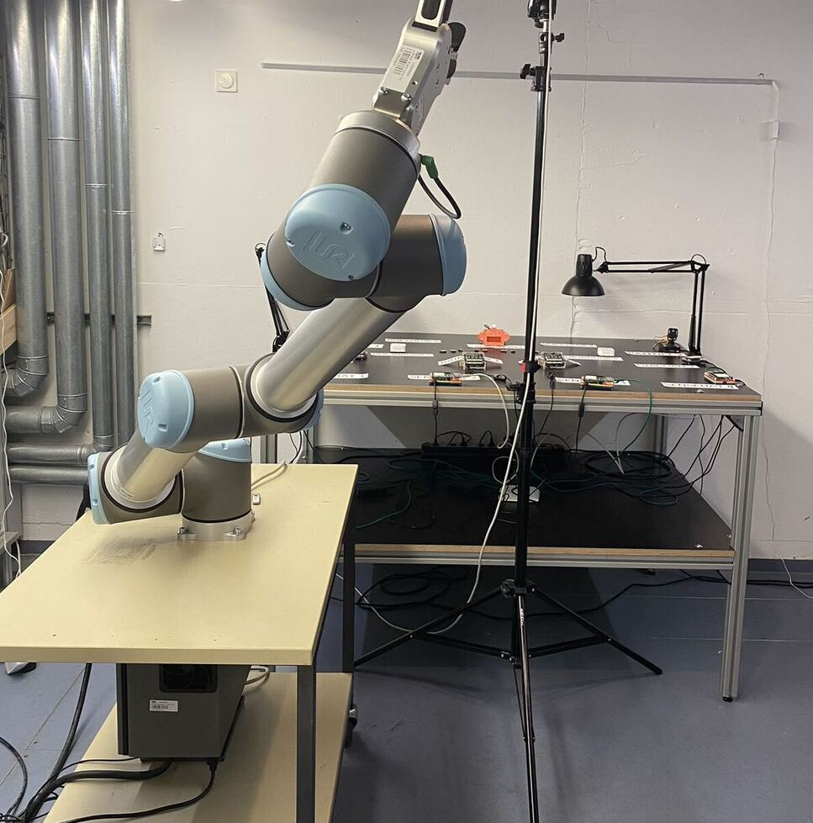
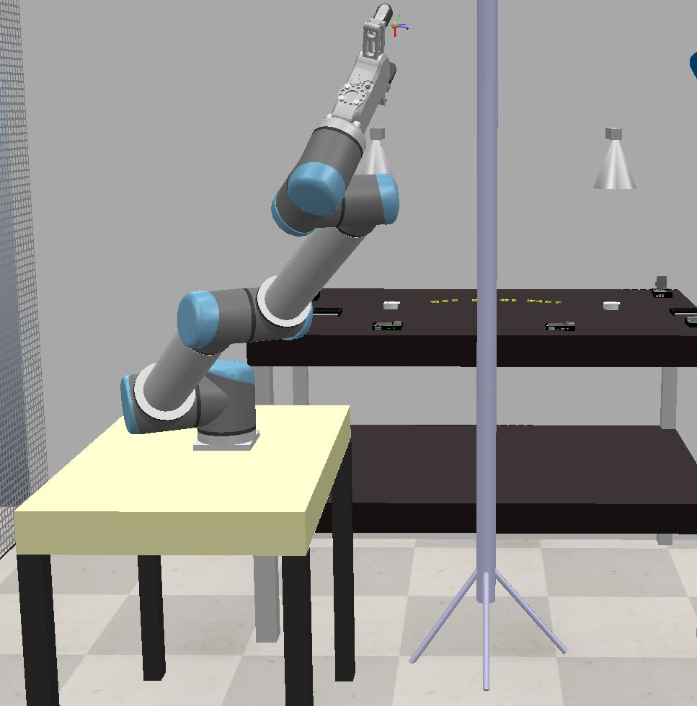
Evaluation results: Thing Description in UR10
Figure: UR10 robot motion posture

Slide 26
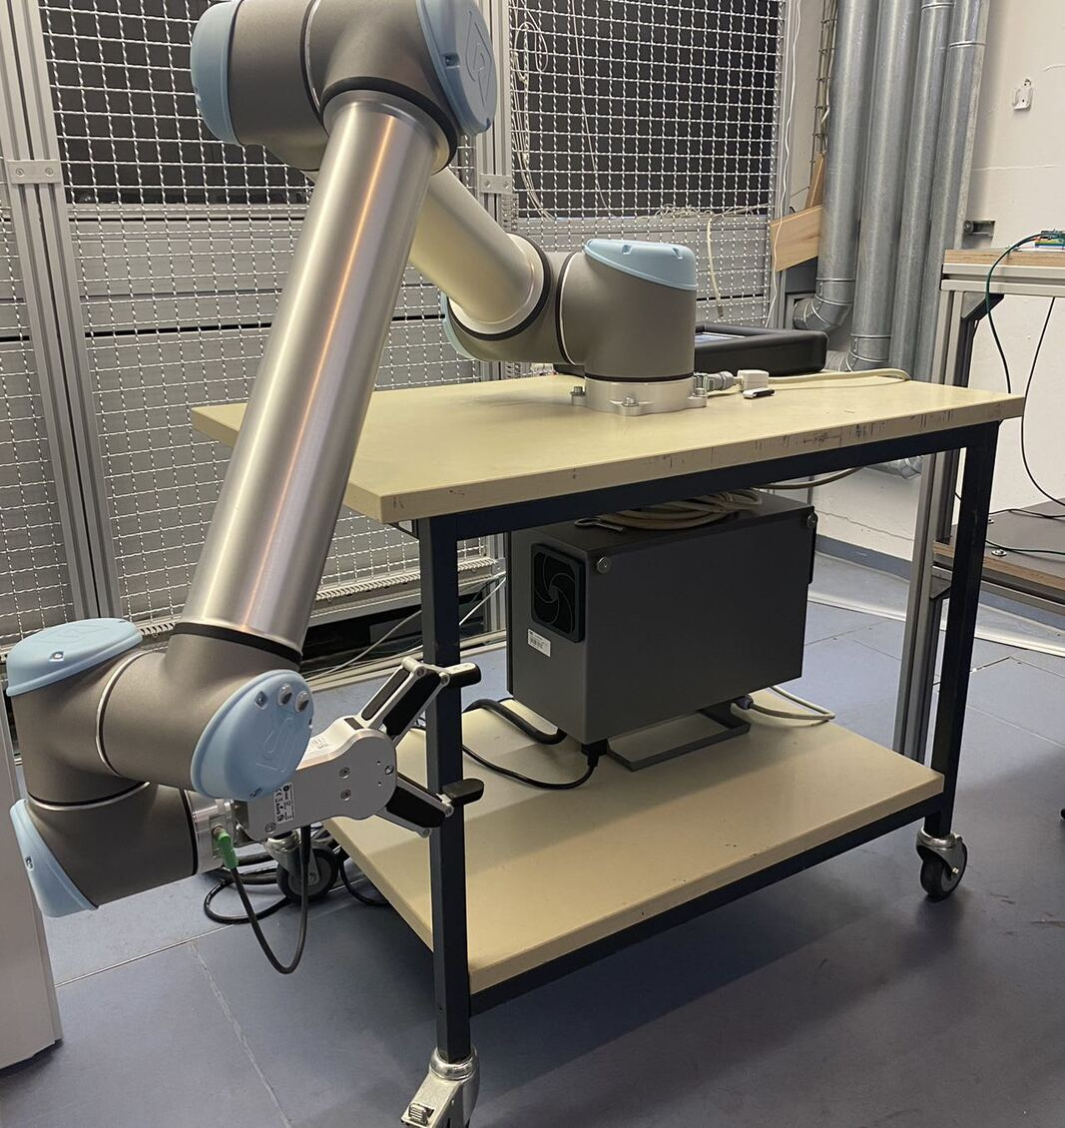
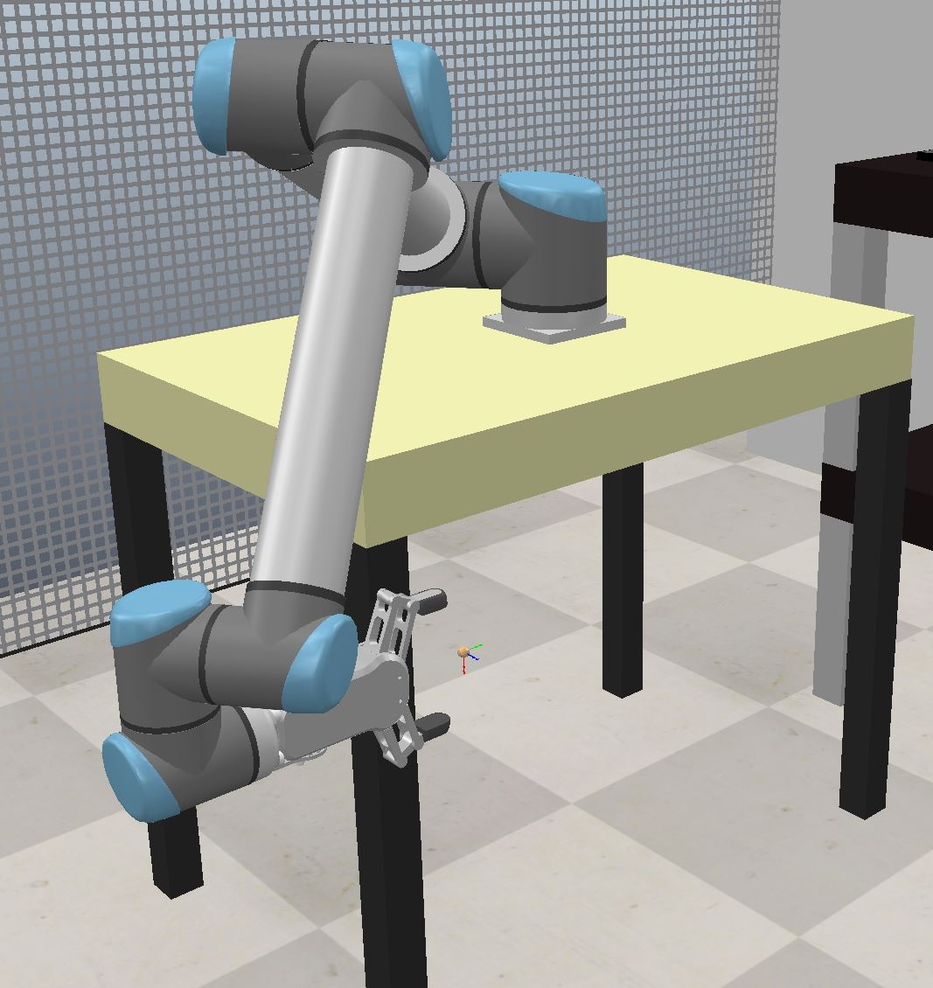
Evaluation results: Thing Description in UR10
Figure: UR10 robot motion posture

Slide 27
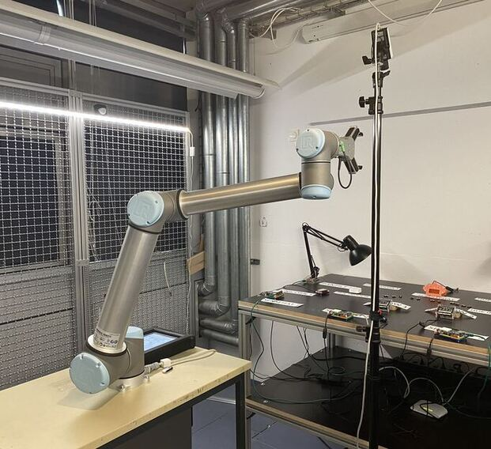
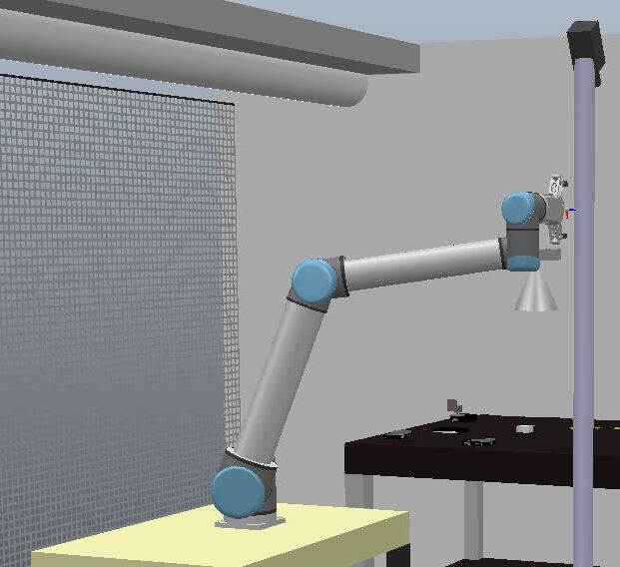
Evaluation results: Thing Description in UR10
Figure: UR10 robot motion posture

Slide 28
Conclusion & Summary
The simulation framework with full functionality and same response ability
Automatically generate the digital twin of robot and mimic its kinematics behavior
Automatically generate the precise Thing Description of robot
Restrictions: Manually establish environment constraints

Slide 29
References
[1] Lagally, M., Matsukura, R., McCool, M., & Toumura, K. (2023, January 19). Web of Things (WoT) Architecture 1.1. https://www.w3.org/TR/wot-architecture11/.
[2] Edelsbrunner, H., Kirkpatrick, D., & Seidel, R. (1983). On the shape of a set of points in the plane. IEEE Transactions on information theory, 29(4), 551-559.
[3] Pham, V. C., Xin, T., Sioutis, M., & Tan, Y. (2022, October). Bridging the ECHONET Lite Protocol and the W3C Web of Things for Smart Homes in Japan. In 2022 IEEE 11th Global Conference on Consumer Electronics (GCCE) (pp. 781-785). IEEE
[4] Tursynbek, I., & Shintemirov, A. (2020, December). Modeling and simulation of spherical parallel manipulators in CoppeliaSim (V-REP) robot simulator software. In 2020 International Conference Nonlinearity, Information and Robotics (NIR) (pp. 1-6). IEEE.
[5] Korkan, E., Salama, F., Kaebisch, S., & Steinhorst, S. (2021, May). A-MaGe: Atomic mashup generator for the web of things. In Web Engineering: 21st International Conference, ICWE 2021, Biarritz, France, May 18–21, 2021, Proceedings (pp. 320-327). Cham: Springer International Publishing.
[6] Pastor-Vargas, R., Tobarra, L., Robles-Gómez, A., Martin, S., Hernández, R., & Cano, J. (2020). A wot platform for supporting full-cycle iot solutions from edge to cloud infrastructures: A practical case. Sensors, 20(13), 3770.

Slide 30
Questions & Answers

